Slide 1

Князева Татьяна Юрьевна
учитель начальных классов
МОУ СОШ № 144
г.Нижний Новгород
Состав чисел
в пределах 10

Slide 2
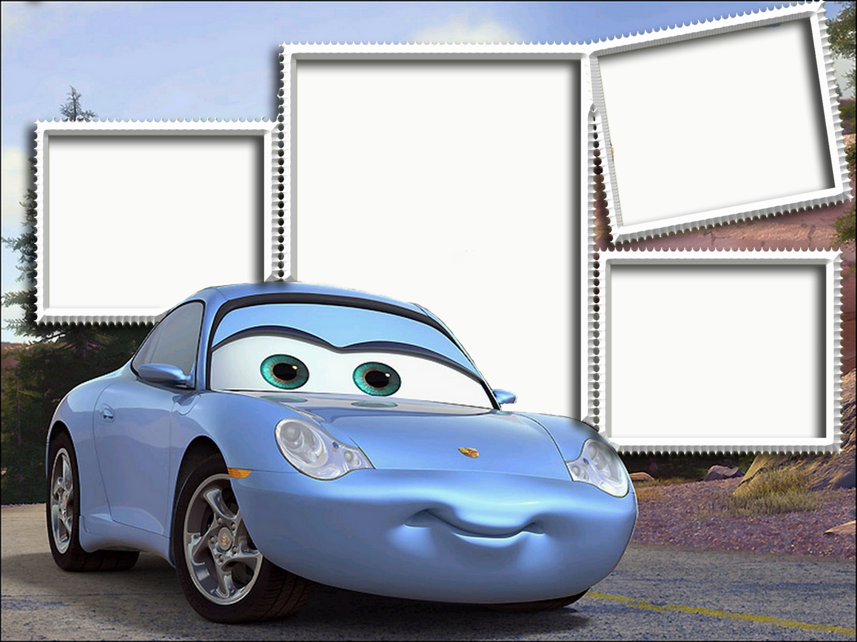
Состав числа 9
Состав числа 8
В - 1
В - 2
В - 2
В - 1
Состав числа 7
В - 1
В - 2
Состав числа 10
В - 1
В - 2

Slide 3
7 = 2 +
5
7 = + 1
6
5
6
4
7 = 4 +
3
6
5
7
3
4
2
7 = + 0
7
6
7
8

Slide 4
7 = + 7
0
7 = 5 +
2
1
2
0
7 = + 6
1
3
1
2
2
0
1
7 = 3 +
4
4
3
5

Slide 5
7 = 0 +
7
7 = + 5
2
8
7
6
7 = 6 +
1
3
1
2
1
2
0
7 = + 3
4
4
5
3

Slide 6
7 = + 5
2
7 = 4 +
3
1
2
3
7 = + 7
0
3
4
2
2
0
1
7 = 6 +
1
2
0
1

Slide 7
7 = 5 +
2
7 = + 6
1
2
3
1
7 = 3 +
4
1
2
0
3
4
5
7 = + 0
7
6
7
8

Slide 8
7 = + 1
6
7 = 2 +
5
4
5
6
7 = + 4
3
5
6
4
2
4
3
7 = 7 +
0
0
1
2

Slide 9
8 = 2 +
6
8 = + 1
7
5
6
7
8 = 4 +
4
6
8
7
3
4
5
8 = + 5
3
2
4
3

Slide 10
8 = + 6
2
8 = 0 +
8
1
2
3
8 = + 3
5
9
8
7
5
6
4
8 = 7 +
1
0
1
2

Slide 11
8 = 1 +
7
8 = + 4
4
8
7
6
8 = 8 +
0
3
4
5
1
2
0
8 = + 5
3
4
2
3

Slide 12
8 = + 5
3
8 = 4 +
4
4
3
2
8 = + 7
1
3
5
4
1
0
2
8 = 6 +
2
3
2
1

Slide 13
8 = 8 +
0
8 = + 3
5
2
1
0
8 = 1 +
7
6
4
5
7
6
8
8 = + 2
6
6
7
5

Slide 14
8 = + 1
7
8 = 0 +
8
6
8
7
8 = + 4
4
9
7
8
4
3
5
8 = 2 +
6
6
5
7

Slide 15
9 = 2 +
7
9 = + 4
5
8
6
7
9 = 6 +
3
6
4
5
3
4
2
9 = + 1
8
8
7
9

Slide 16
9 = + 7
2
9 = 3 +
6
1
2
3
9 = + 8
1
5
7
6
3
1
2
9 = 0 +
9
8
9
7

Slide 17
9 = 9 +
0
9 = + 5
4
0
1
2
9 = 3 +
6
6
4
5
6
5
7
9 = + 2
7
8
7
6

Slide 18
9 = + 3
6
9 = 2 +
7
5
6
7
9 = + 4
5
8
7
6
6
5
4
9 = 5 +
4
3
5
4

Slide 19
9 = 9 +
0
9 = + 5
4
2
1
0
9 = 1 +
8
3
4
5
7
9
8
9 = + 6
3
2
4
3

Slide 20
9 = + 7
2
9 = 4 +
5
1
2
3
9 = + 0
9
5
4
6
8
9
7
9 = 8 +
1
2
0
1

Slide 21
10 = + 6
4
10 = 3 +
7
5
4
3
10 = + 10
0
8
7
6
1
0
2
10 = 5 +
5
6
5
4

Slide 22
10 = 7 +
3
10 = + 1
9
2
3
4
10 = 2 +
8
7
8
9
7
9
8
10 = + 4
6
5
6
7

Slide 23
10 = + 9
1
10 = 10 +
0
1
2
0
10 = + 3
7
0
1
2
8
6
7
10 = 8 +
2
2
3
1

Slide 24
10 = 1 +
9
10 = + 4
6
8
9
7
10 = 8 +
2
6
7
5
3
1
2
10 = + 7
3
4
3
2

Slide 25
10 = + 9
1
10 = 6 +
4
1
2
0
10 = + 5
5
5
3
4
5
4
6
10 = 10 +
0
1
0
2

Slide 26
10 = 7 +
3
10 = + 10
0
3
4
2
10 = 2 +
8
0
1
2
9
8
7
10 = + 6
4
5
4
3

Slide 27
Использованы источники:
http://ka4ka.net/uploads/posts/2010-03/1267722095_tachki.jpg - рамка тачки
http://allday.ru/uploads/posts/2009-01/1232128662_28-1.jpg - рамка тачки

